Slide 1

Ethanol Blending Program in India
SUBMITTED BY –
Rohit Kumar – NF1003118
Krishna Patel – NF1017043
Heta Chavda - NF1014555

Slide 2

Overview
The case study uses diverse visualizations to examine India's ethanol blending program.
Analyzes correlations among economic, political, social, technological, and environmental factors.
Explores trends, inefficiencies, and impacts on sustainability, fuel demand, and consumer acceptance.

Slide 3
Objective
Assess program effectiveness in reducing carbon emissions and improving sustainability.
Evaluate technological and economic challenges influencing production and adoption.
Offer actionable recommendations to optimize policies, investments, and communication strategies.
Purpose
To comprehensively study the multi-dimensional impacts of India's ethanol blending program.
To support data-driven decision-making for enhancing program efficiency and acceptance.
To contribute to sustainability goals by identifying key areas for improvement.

Slide 4
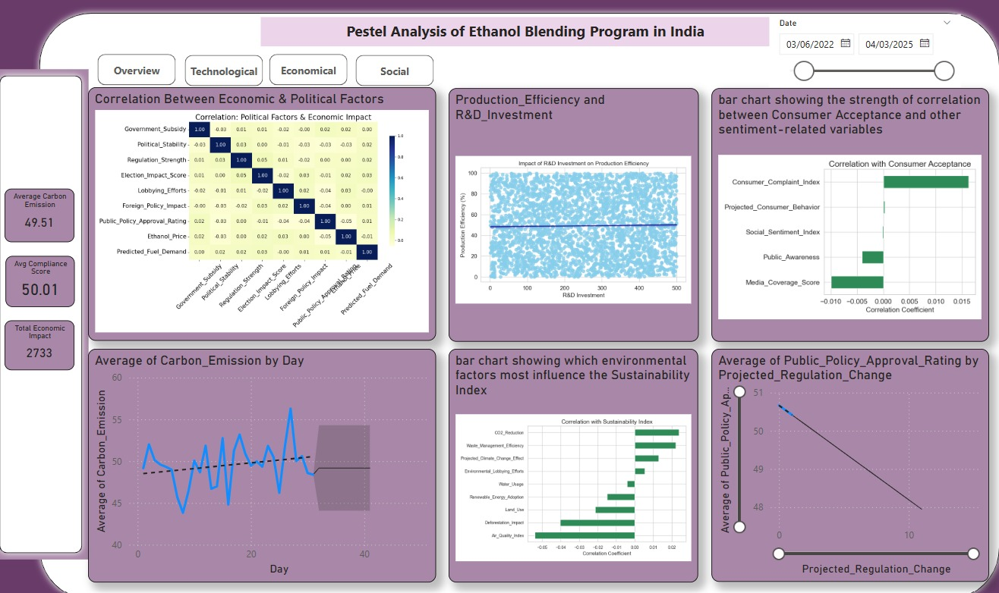
Overview of the Pestel analysis

Slide 5
Pestel Analysis Factors
Economical Factor
Technological Factor
Social Factor
Legal Factor
Environmental Factor

Slide 6
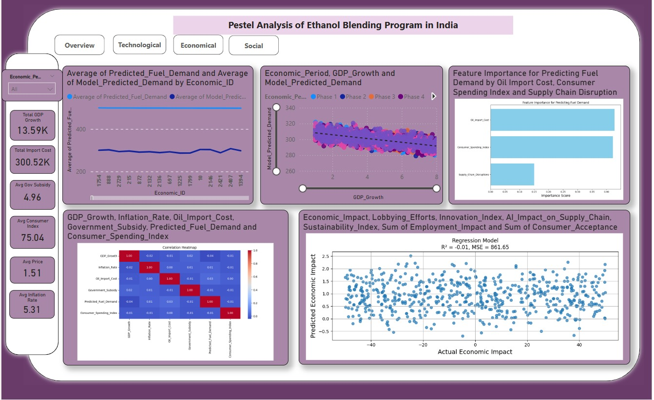
Economical Factor

Slide 7
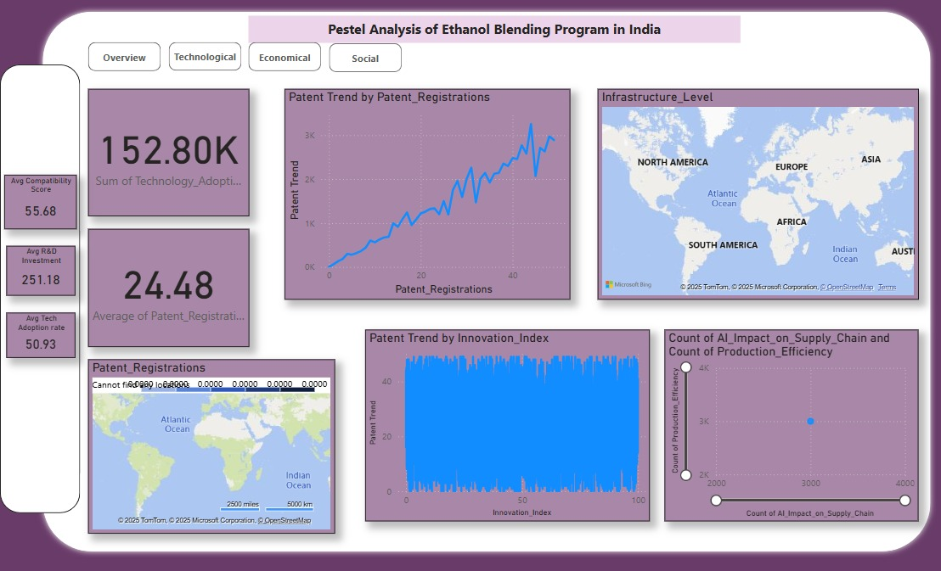
Technological Factor

Slide 8
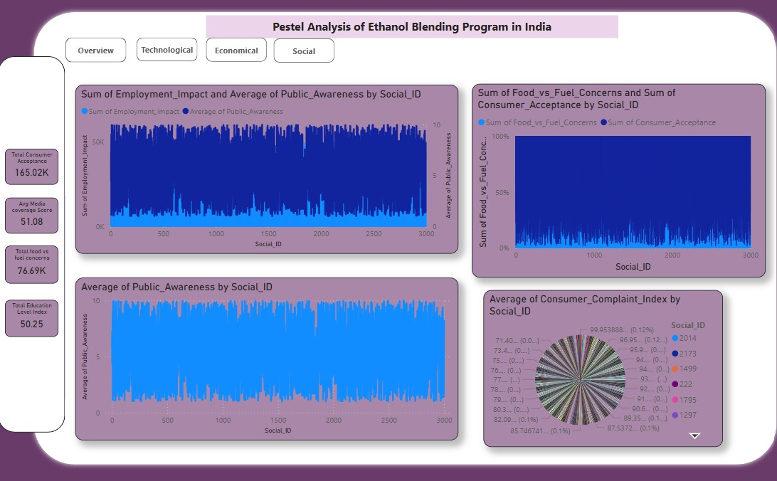
Social Factor

Slide 9
Legal Factor
Policy Stability: Frequent policy changes create uncertainty and reduce public trust.
Regulation Impact: Weak correlation with economic outcomes suggests potential for improvement.
Communication: Transparent dissemination of policies is essential for public support.
Environmental factor
Carbon Emissions: Declining emissions signal progress in sustainability efforts.
Waste Management: Efficient handling of waste boosts the Sustainability Index.
Air Quality: Poor air quality highlights the need for pollution control.
Renewable Energy: Moderately supports sustainability alongside emissions reduction.

Slide 10
Conclusion and Recomendations
Summary of Key insights
The ethanol blending program shows multi-dimensional impacts across economic, political, technological, environmental, and social factors.
Carbon emissions reduction, waste management, and public trust are key drivers of success.
Frequent policy changes and unresolved consumer complaints hinder progress.
Strategy Recommendations
Stabilize policies and improve communication for public trust.
Focus on CO₂ reduction, waste management, and AI-driven supply chain improvements.
Prioritize addressing consumer complaints to boost acceptance.

Slide 11

Thank You :)

